Slide 1
CREATING AND RUNNING CONTAINERS
Introduction
Container Images
Building Application Images with Docker
Multistage Image Builds
Storing Images in a Remote Registry
The Docker Container Runtime

Slide 2
INTRODUCTION
Kubernetes is an open source orchestrator for deploying containerized applications.
  It was originally developed by Google – 2014.
Kubernetes has grown to be one of the largest & most popular open source projects in the world.
  It has become the standard API for building cloud-native applications, present in nearly every public cloud.
It is a proven infrastructure for distributed systems that is suitable for cloud-native developers of all scales,
  from a cluster of Raspberry Pi computers to warehouse full of the latest machines.
It provides the software necessary to successfully build and deploy reliable, scalable distributed systems

Slide 3
Reliable, scalable distributed systems:
More and more services are delivered over network via APIs.
These APIs are often delivered by a distributed system, the various pieces that implement the API running on different machines, connected via the network and coordinating their actions via network communication.
As we rely on these APIs (increasingly for all aspects of our daily lives), these systems must be highly reliable.
They cannot fail, even if a part of the system crashes or otherwise stops working.
Likewise, they must maintain availability even during software rollouts or other maintenance events.
Finally, as more and more of the world is coming online and using such services, they must be highly scalable so that they can grow their capacity to keep up with ever-increasing usage without radical redesign of the distributed system that implements the services.

Slide 4
There are many reasons why people use containers and container APIs like Kubernetes, but they can all be traced back to one of these benefits:
• Velocity
• Scaling (of both software and teams)
• Abstracting your infrastructure
• Efficiency

Slide 5
CREATING AND RUNNING CONTAINERS
Kubernetes is a platform for creating, deploying, and managing distributed applications.
  These applications come in many different shapes & sizes,
  but ultimately, they are all comprised of one or more programs that run on individual machines.
These programs accept input, manipulate data, and then return the results.
Application programs are typically comprised of a language runtime, libraries, and your source code.
  In many cases, application relies on external shared libraries such as libc and libssl.
  These external libraries are generally shipped as shared components in the OS that you have installed on a particular machine

Slide 6
This dependency on shared libraries causes problems when an application developed on a programmer’s laptop has a dependency on a shared library that isn’t available when the program is rolled out to the production OS.
Even when the development and production environments share the exact same version of the OS, problems can occur when developers forget to include dependent asset files inside a package that they deploy to production.
Traditional methods of running multiple programs on a single machine require that all of these programs share the same versions of shared libraries on the system.
If the different programs are developed by different teams or organizations, these shared dependencies add needless complexity and coupling between these teams.
A program can only execute successfully if it can be reliably deployed onto the machine where it should run.

Slide 7
When working with applications it’s often helpful to package them in a way that makes it easy to share them with others.
Docker, the default container runtime engine,
- makes it easy to package an executable &
- push it to a remote registry where it can later be pulled by others.
Container registries are available in all of the major public clouds,
Also services to build images in the cloud are available in many of them.
You can also run your own registry using open source or commercial systems.
These registries make it easy for users to manage and deploy private images, while image-builder services provide easy integration with continuous delivery systems.

Slide 8
Container images bundle a program and its dependencies into a single artifact under a root filesystem.
The most popular container image format is the Docker image format, which has been standardized by the Open Container Initiative to the OCI image format.
Kubernetes supports both Docker- and OCI-compatible images via Docker and other runtimes.
Docker images also include additional metadata used by a container runtime to start a running application instance based on the contents of the container image.

Slide 9
CONTAINER IMAGES
For nearly everyone, their first interaction with any container technology is with a container image.
A container image is a binary package that encapsulates all of the files necessary to run a program inside of an OS container.
Depending on experiment with containers, you will either build a container image from your local filesystem or download a preexisting image from a container registry.
In either case, once the container image is present on your computer, you can run that image to produce a running application inside an OS container

Slide 10
THE DOCKER IMAGE FORMAT
Most popular and widespread container image format is the Docker image format, which was developed by the Docker open source project for packaging, distributing, and running containers using the docker command.
Subsequently, work has begun by others to standardize container image format via Open Container Initiative (OCI) project.
The Docker image format continues to be the de facto standard, and is made up of a series of filesystem layers.
  Each layer adds, removes, or modifies files from the preceding layer in the filesystem. This is an example of an overlay filesystem.
  The overlay system is used both when packaging up the image and when the image is actually being used.

Slide 11
Container images are typically combined with a container configuration file, which provides instructions on how to set up the container environment and execute an application entry point.
The container configuration often includes information on how to set up networking, namespace isolation, resource constraints (cgroups), and what syscall restrictions should be placed on a running container instance.
The container root filesystem and configuration file are typically bundled using the Docker image format

Slide 12
Containers fall into two main categories:
• System containers
• Application containers
System containers seek to mimic virtual machines and often run a full boot process.
  They often include a set of system services typically found in a VM, such as ssh, cron, and syslog.
  When Docker was new, these types of containers were much common.
  Over time, application containers have gained favor.
Application containers differ from system containers in that they commonly run a single program.
  While running a single program per container might seem like an unnecessary constraint, it provides the perfect level of granularity for composing scalable applications.

Slide 13
BUILDING APPLICATION IMAGES WITH DOCKER
In general, container orchestration systems like Kubernetes are focused on building and deploying distributed systems made up of application containers.
Docker files:
A Docker file can be used to automate the creation of a Docker container image.
Let’s start by building an application image for a simple Node.js program. This example would be very similar for many other dynamic languages, like Python or Ruby.

Slide 14
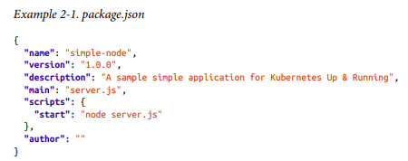
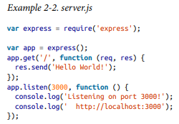
The simplest of npm/Node/Express apps has two files: package.json (Example 2-1) and server.js (Example 2-2).
Put these in a directory and then run npm install express --save to establish a dependency on Express and install it.

Slide 15
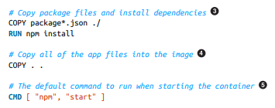
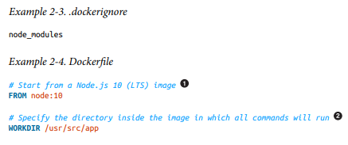
To package this up as a Docker image we need to create two additional files:
.docker‐ ignore (Example 2-3) & the Dockerfile (Ex 2-4).
The Dockerfile is a recipe for how to build the container image, while .dockerignore defines the set of files that should be ignored when copying files into the image.
A full description of the syntax of the Dockerfile is available on the Docker website

Slide 16
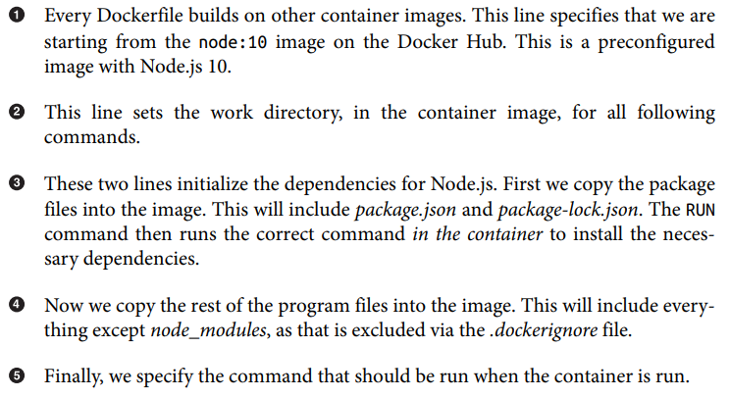

Slide 17
Run the following command to create the simple-node Docker image:
$ docker build -t simple-node .
When you want to run this image, you can do it with the following command. You can navigate to http://localhost:3000 to access the program running in the container:
$ docker run --rm -p 3000:3000 simple-node
At this point our simple-node image lives in the local Docker registry where the image was built and is only accessible to a single machine.
The true power of Docker comes from the ability to share images across thousands of machines and the broader Docker community

Slide 18
OPTIMIZING IMAGE SIZES
There are several gotchas when people begin to experiment with container images.
The first thing is that files that are removed by subsequent layers in the system are actually still present in the images; they’re just inaccessible.
Consider the following situation:
└── layer A: contains a large file named 'BigFile‘
└── layer B: removes 'BigFile'
└── layer C: builds on B by adding a static binary
You might think that BigFile is no longer present in this image. After all, when you run the image, it is no longer accessible.
But in fact it is still present in layer A, which means that whenever you push or pull the image, BigFile is still transmitted through the network, even if you can no longer access it.

Slide 19
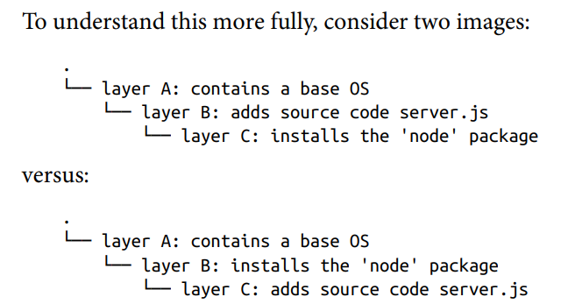
Another pitfall that people fall into revolves around image caching and building.
Every time you change a layer, it changes every layer that comes after it.
Changing the preceding layers means that they need to be rebuilt, repushed, and repulled to deploy your image to development.

Slide 20
It seems obvious that both of these images will behave identically, and indeed the first time they are pulled they do.
However, consider what happens when server.js changes.
In one case, it is only the change that needs to be pulled or pushed, but in the other case, both server.js and the layer providing the node package need to be pulled and pushed, since the node layer is dependent on the server.js layer.
In general, you want to order your layers from least likely to change to most likely to change in order to optimize the image size for pushing and pulling.

Slide 21
IMAGE SECURITY
When building images that will ultimately run in a production Kubernetes cluster, be sure to follow best practices for packaging and distributing applications.
For example, don’t build containers with passwords baked in—and this includes not just in the final layer, but any layers in the image.
One of the counterintuitive problems introduced by container layers is that deleting a file in one layer doesn’t delete that file from preceding layers.
It still takes up space, and it can be accessed by anyone with the right tools—an enterprising attacker can simply create an image that only consists of the layers that contain the password.

Slide 22
MULTISTAGE IMAGE BUILDS
One of the most common ways to accidentally build large images is to do the actual program compilation as part of the construction of the application container image.
Compiling code as part of the image build is the easiest way to build a container image from your program.
The trouble with this is it leaves all of the unnecessary development tools, which are usually quite large, lying around inside of your image and slowing down your deployments.
To resolve this problem, Docker introduced multistage builds.
With multistage builds, rather than producing a single image, a Docker file can actually produce multiple images. Each image is considered a stage. Artifacts can be copied from preceding stages to the current stage.

Slide 23
To illustrate this concretely, we will look at how to build our example application, kuard.
This is a somewhat complicated application that involves a React.js frontend (with its own build process) that then gets embedded into a Go program.
The Go program runs a backend API server that the React.js frontend interacts with.

Slide 24
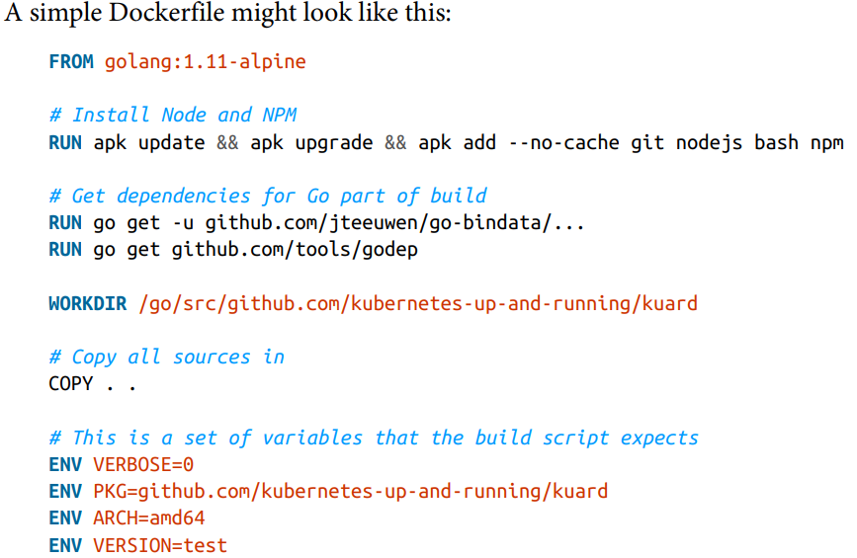
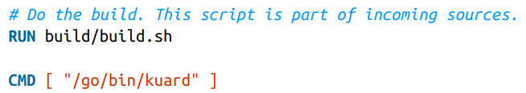

Slide 25
This Dockerfile produces a container image containing a static executable, but it also contains all of the Go development tools and the tools to build the React.js frontend and the source code for the application, neither of which are needed by the final application.
The image, across all layers, adds up to over 500 MB.

Slide 26
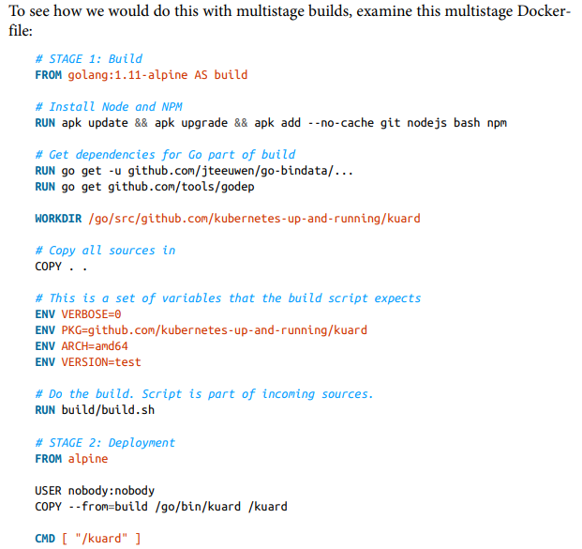

Slide 27

This Dockerfile produces two images.
The first is the build image, which contains the Go compiler, React.js toolchain, and source code for the program.
The second is the deployment image, which simply contains the compiled binary.
Building a container image using multistage builds can reduce your final container image size by hundreds of megabytes and thus dramatically speed up your deployment times.
The final image produced from this Dockerfile is somewhere around 20 MB. You can build and run this image with the following commands:

Slide 28
STORING IMAGES IN A REMOTE REGISTRY
What good is a container image if it’s only available on a single machine?
Kubernetes relies on the fact that images described in a Pod manifest are available across every machine in the cluster.
One option for getting this image to all machines in the cluster would be to export the kuard image and import it on each of them – which is a very tedious task.
The process of manually importing and exporting Docker images has human error written all over it.
The standard within the Docker community is to store Docker images in a remote registry.

Slide 29
Thus, the first choice you need to make regarding a registry is whether to use a private or a public registry.
Public registries allow anyone to download images stored in the registry, while private registries require authentication to down‐ load images.
In choosing public versus private, it’s helpful to consider your use case.
Public registries are great for sharing images with the world, because they allow for easy, unauthenticated use of the container images. You can easily distribute your software as a container image.
In contrast, a private registry is best for storing applications that are private to your service and that you don’t want the world to use.

Slide 30
Regardless, to push an image, you need to authenticate to the registry.
You can generally do this with the docker login command.
Once you are logged in, you can tag the kuard image by prepending the target Docker registry.
You can also append another identifier that is usually used for the version or variant of that image, separated by a colon (:):
$ docker tag kuard gcr.io/kuar-demo/kuard-amd64:blue
Then you can push the kuard image:
$ docker push gcr.io/kuar-demo/kuard-amd64:blue
Now that the kuard image is available on a remote registry, it’s time to deploy it using Docker.
Because we pushed it to the public Docker registry, it will be available every‐ where without authentication.

Slide 31
THE DOCKER CONTAINER RUNTIME
Kubernetes provides an API for describing an application deployment, but relies on a container runtime to set up an application container using the container-specific APIs native to the target OS.
On a Linux system that means configuring cgroups and namespaces.
The interface to this container runtime is defined by the Container Run‐ time Interface (CRI) standard.
The CRI API is implemented by a number of different programs, including the containerd-cri built by Docker and the cri-o implementation contributed by Red Hat.

Slide 32
RUNNING CONTAINERS WITH DOCKER
Though generally in Kubernetes containers are launched by a daemon on each node called kubelet, it’s easier to get started with containers using the Docker command-line tool.
The Docker CLI tool can be used to deploy containers.
To deploy a container from the gcr.io/kuar-demo/kuard-amd64:blue image, run the following command:
$ docker run -d --name kuard \ --publish 8080:8080 \ gcr.io/kuar-demo/kuard-amd64:blue
This command starts the kuard container and maps ports 8080 on your local machine to 8080 in the container.
The --publish option can be shortened to -p.
This forwarding is necessary because each container gets its own IP address.
Without the port forwarding, connections will be inaccessible to your machine. The -d option specifies that this should run in the background (daemon), while --name kuard gives the container a friendly name.

Slide 33
EXPLORING THE KUARD APPLICATION
kuard exposes a simple web interface, which you can load by pointing your browser at
http://localhost:8080
or via the command line:
$ curl http://localhost:8080

Slide 34
LIMITING RESOURCE USAGE
One of the key benefits to running applications within a container is the ability to restrict resource utilization.
This allows multiple applications to coexist on the same hardware and ensures fair usage.
To limit kuard to 200 MB of memory and 1 GB of swap space, use the --memory and --memory-swap flags with the docker run command.
Stop and remove the current kuard container:
$ docker stop kuard $ docker rm kuard
Then start another kuard container using the appropriate flags to limit memory usage:
$ docker run -d --name kuard \ --publish 8080:8080 \ --memory 200m \ --memory-swap 1G \ gcr.io/kuar-demo/kuard-amd64:blue
Note: If the program in the container uses too much memory, it will be terminated

Slide 35
Limiting CPU resources
Another critical resource on a machine is the CPU.
Restrict CPU utilization using the --cpu-shares flag with the docker run command:
$ docker run -d --name kuard \ --publish 8080:8080 \ --memory 200m \ --memory-swap 1G \ --cpu-shares 1024 \ gcr.io/kuar-demo/kuard-amd64:blue

Slide 36
CLEANUP
Once you are done building an image, you can delete it with the docker rmi command: docker rmi
docker rmi Images can either be deleted via their tag name (e.g., gcr.io/kuar-demo/kuardamd64:blue) or via their image ID.
It’s important to note that unless you explicitly delete an image it will live on your system forever, even if you build a new image with an identical name.
Building this new image simply moves the tag to the new image; it doesn’t delete or replace the old image.
Consequently, as you iterate while you are creating a new image, you will often create many, many different images that end up taking up unnecessary space on your computer.
To see the images currently on your machine, you can use the docker images command.
Docker provides a tool called docker system prune for doing general cleanup. This will remove all stopped containers, all untagged images, and all unused image layers cached as part of the build process.

